Slide 1
Software Quality Assurance
Dr. Seemab Latif
Lecture No. 14
22nd Decemnber, 2010

Slide 2
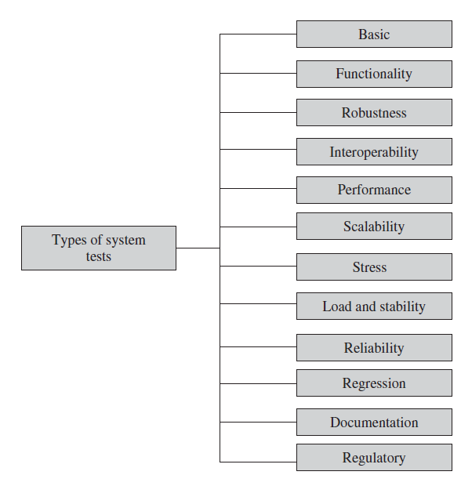
Taxonomy of System Tests
DONE
THIS LECTURE

Slide 3
4. Interoperability
In this category, tests are designed to verify the ability of the system to interoperate with third-party products. An interoperability test typically combines different network elements in one test environment to ensure that they work together. In other words, tests are designed to ensure that the software can be connected with other systems and operated.
In many cases, during interoperability tests, users may require the hardware devices to be interchangeable, removable, or reconfigurable. Often, a system will have a set of commands or menus that allow users to make the configuration changes.
The reconfiguration activities during interoperability tests are known as configuration testing. Another kind of interoperability test is called a (backward) compatibility test . Compatibility tests verify that the system works the same way across different platforms, operating systems, and database management systems.
Backward compatibility tests verify that the current software build flawlessly works with older version of platforms.

Slide 4
5. Performance Tests
Performance tests are designed to determine the performance of the actual system compared to the expected one. The performance metrics needed to be measured vary from application to application.
An example of expected performance is: The response time should be less than 1 millisecond 90% of the time in an application of the “push-to-talk” type.
Another example of expected performance is: A transaction in an on-line system requires a response of less than 1 second 90% of the time.
One of the goals of router performance testing is to determine the system resource utilization, for maximum aggregation throughput rate considering zero drop packets.
In this category, tests are designed to verify response time, execution time, throughput, resource utilization, and traffic rate.

Slide 5
Performance
For performance tests, one needs to be clear about the specific data to be captured in order to evaluate performance metrics. For example, if the objective is to evaluate the response time, then one needs to capture
end-to-end response time (as seen by external user),
CPU time,
network connection time,
database access time,
network connection time
waiting time.
The results of performance are evaluated for their acceptability. If the performance metric is unsatisfactory, then actions are taken to improve it. The performance improvement can be achieved by rewriting the code, allocating more resources, and redesigning the system.

Slide 6
6. Scalability
All man-made artifacts have engineering limits.
For example, a car can move at a certain maximum speed in the best of road conditions, a telephone switch can handle a certain maximum number of calls at any given moment, a router has a certain maximum number of interfaces, and so on.
In this group, tests are designed to verify that the system can scale up to its engineering limits. A system may work in a limited-use scenario but may not scale up. The run time of a system may grow exponentially with demand and may eventually fail after a certain limit.
The idea is to test the limit of the system, that is, the magnitude of demand that can be placed on the system while continuing to meet latency and throughput requirements.
A system which works acceptably at one level of demand may not scale up to another level. Scaling tests are conducted to ensure that the system response time remains the same or increases by a small amount as the number of users are increased.

Slide 7
Scalability
Systems may scale until they reach one or more engineering limits. There are three major causes of these limitations:
Data storage limitations—limits on counter field size and allocated buffer space
Network bandwidth limitations—Ethernet speed 10 Mbps and T1 card line rate 1.544 Mbps
Speed limit—CPU speed in megahertz

Slide 8
7. Stress Testing
The goal of stress testing is to evaluate and determine the behaviour of a software component while the offered load is in excess of its designed capacity.
The system is deliberately stressed by pushing it to and beyond its specified limits. Stress tests include deliberate contention for scarce resources and testing for incompatibilities.
It ensures that the system can perform acceptably under worst-case conditions under an expected peak load. If the limit is exceeded and the system does fail, then the recovery mechanism should be invoked.

Slide 9
Stress Testing
Stress tests are targeted to bring out the problems associated with one or more of the following:
Memory leak
Buffer allocation and memory carving
One way to design a stress test is to impose the maximum limits on all system performance characteristics at the same time, such as the response time, availability, and throughput thresholds. This literally provides the set of worst-case conditions under which the system is still expected to operate acceptably.

Slide 10
8. Load and Stability Test
Load and stability tests are designed to ensure that the system remains stable for a long period of time under full load. A system might function flawlessly when tested by a few careful testers who exercise it in the intended manner.
However, when a large number of users are introduced with incompatible systems and applications that run for months without restarting, a number of problems are likely to occur:
the system slows down,
the system encounters functionality problems,
the system silently fails over, and
the system crashes altogether.
Load and stability testing typically involves exercising the system with virtual users and measuring the performance to verify whether the system can support the anticipated load.
This kind of testing helps one to understand the ways the system will fare in real-life situations. With such an understanding, one can anticipate and even prevent load-related problems.

Slide 11
Stress and Load and Stability Test
Difference between Load and Stability testing and Stress testing:
In load and stability testing, the objective is to ensure that the system can operate on a large scale for several months, whereas, in stress testing, the objective is to break the system by overloading it to observe the locations and causes of failures.

Slide 12
9. Reliability
Reliability tests are designed to measure the ability of the system to remain operational for long periods of time. The reliability of a system is typically expressed in terms of mean time to failure (MTTF).
As we test the software and move through the system testing phase, we observe failures and try to remove the defects and continue testing. As this progresses, we record the time durations between successive failures.
Let these successive time intervals be denoted by t 1, t 2, . . ., t i. The average of all the i time intervals is called the MTTF.
After a failure is observed, the developers analyze and fix the defects, which consumes some time—let us call this interval the repair time. The average of all the repair times is known as the mean time to repair (MTTR).
Now we can calculate a value called mean time between failures (MTBF) as MTBF = MTTF+MTTR

Slide 13
10. Regression Testing
In this category, new tests are not designed. Instead, test cases are selected from the existing pool and executed to ensure that nothing is broken in the new version of the software.
The main idea in regression testing is to verify that no defect has been introduced into the unchanged portion of a system due to changes made elsewhere in the system.
During system testing, many defects are revealed and the code is modified to fix those defects. As a result of modifying the code, one of four different scenarios can occur for each fix:
The reported defect is fixed.
The reported defect could not be fixed in spite of making an effort.
The reported defect has been fixed, but something that used to work before has been failing.
The reported defect could not be fixed in spite of an effort, and something that used to work before has been failing.

Slide 14
Regression Testing
Given the above four possibilities, it appears straightforward to re-execute every test case from version n −1 to version n before testing anything new.
Such a full test of a system may be prohibitively expensive. Moreover, new software versions often feature many new functionalities in addition to the defect fixes.
Therefore, regression tests would take time away from testing new code. Regression testing is an expensive task; a subset of the test cases is carefully selected from the existing
test suite to:
maximize the likelihood of uncovering new defects and
Reduce the cost of testing.

Slide 15
11. Documentation Test
Documentation testing means verifying the technical accuracy and readability of the user manuals, including the tutorials and the on-line help. Documentation testing is performed at three levels as explained in the following:
Read Test : In this test a documentation is reviewed for clarity, organization, flow, and accuracy without executing the documented instructions on the system.
Hands-On Test : The on-line help is exercised and the error messages verified to evaluate their accuracy and usefulness.
Functional Test : The instructions embodied in the documentation are followed to verify that the system works as it has been documented.

Slide 16
Documentation Testing
The following concrete tests are recommended for documentation testing:
Read all the documentations to verify (i) correct use of grammar, (ii) consistent use of the terminology, and (iii) appropriate use of graphics where possible.
Verify that the glossary accompanying the documentation uses a standard, commonly accepted terminology and that the glossary correctly defines the terms.
Verify that there exists an index for each of the documents and the index block is reasonably rich and complete. Verify that the index section points to the correct pages.
Verify that there is no internal inconsistency within the documentation.
Verify that the on-line and printed versions of the documentation are same.
Verify the installation procedure by executing the steps described in the manual in a real environment.

Slide 17
Documentation Testing
Verify the troubleshooting guide by inserting error and then using the guide to troubleshoot the error.
Verify the software release notes to ensure that these accurately describe (i) the changes in features and functionalities between the current release and the previous ones and (ii) the set of known defects and their impact on the customer.
Verify the on-line help for its (i) usability, (ii) integrity, (iii) usefulness of the hyperlinks and cross-references to related topics, (iv) effectiveness of table look-up, and (v) accuracy and usefulness of indices.
Verify the configuration section of the user guide by configuring the system as described in the documentation. Finally, use the document while executing the system test cases. Walk through the planned or existing user work activities and procedures using the documentation to ensure that the documentation is consistent with the user work.

Slide 18
12. Regulatory Testing
In this category, the final system is shipped to the regulatory bodies in those countries where the product is expected to be marketed. The idea is to obtain compliance marks on the product from those bodies.

Slide 19
Summary
In this lecture we learned a taxonomy of system tests with examples from various domains. We explained the following categories of system tests:
Basic tests provide an evidence that the system can be installed, configured, and brought to an operational state. We described five types of basic tests: boot, upgrade/downgrade, light emitting diode, diagnostic, and command line interface tests.
Functionality tests provide comprehensive testing over the full range of the requirements within the capabilities of the system. In this category, we described eight types of tests: communication systems, module, logging and tracing, element management systems, management information base, graphical user interface, security, and feature tests.
Robustness determine the system recovery process from various error conditions or failure situations. In this category, we described five types of robustness tests: boundary value, power cycling, on-line insertion and removal, high availability, degraded node tests.
Interoperability determine if the system can interoperate with other third-party products.
Performance measure the performance characteristics of the system, for example, throughput and response time, under various conditions.

Slide 20
Summary
Scalability tests determine the scaling limits of the system.
Stress tests stress the system in order to determine the limitations of the system and determine the manner in which failures occur if the system fails.
Load and stability provide evidence that, when the system is loaded with a large number of users to its maximum capacity, the system is stable for a long period of time under heavy traffic.
Reliability tests measure the ability of the system to keep operating over long periods of time.
Regression tests determine that the system remains stable as it cycles through the integration with other projects and through maintenance tasks.
Documentation tests ensure that the system’s user guides are accurate and usable.
Regulatory tests ensure that the system meets the requirements of government regulatory bodies. Most of these regulatory bodies issue safety, emissions, and immunity compliance certificates.

